Slide 1
DDM
Exp1 individual analysis

Slide 2
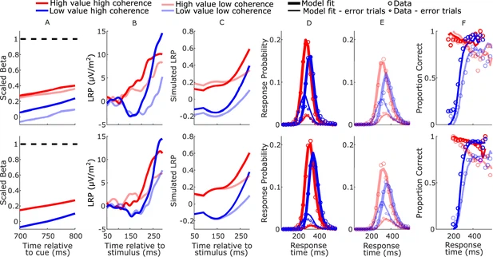
Example data and fit

Slide 3
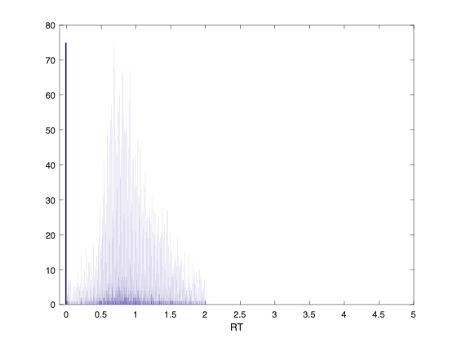
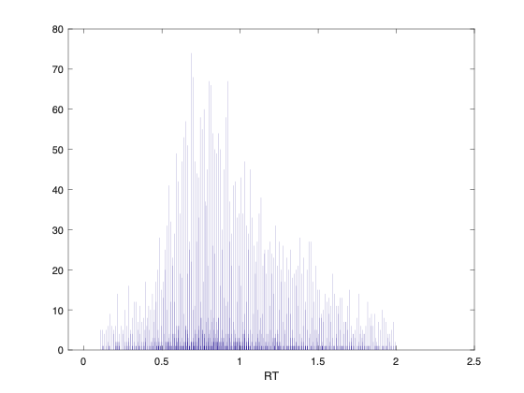
RT for all sub （0.1-2 ddl）

Slide 4
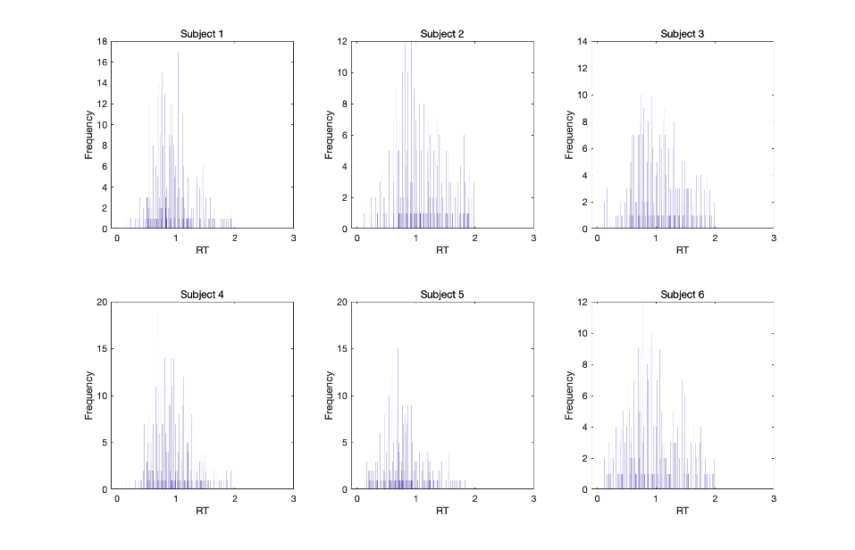
RT for sub 1-6

Slide 5
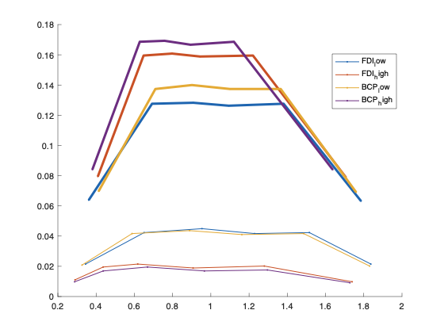
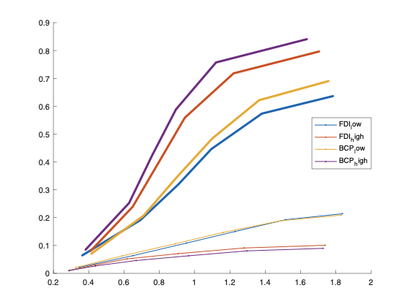
CDF and PDF for all data

Slide 6
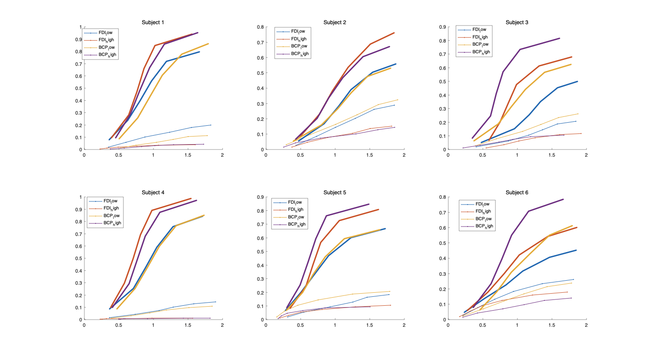
CDF per subject

Slide 7
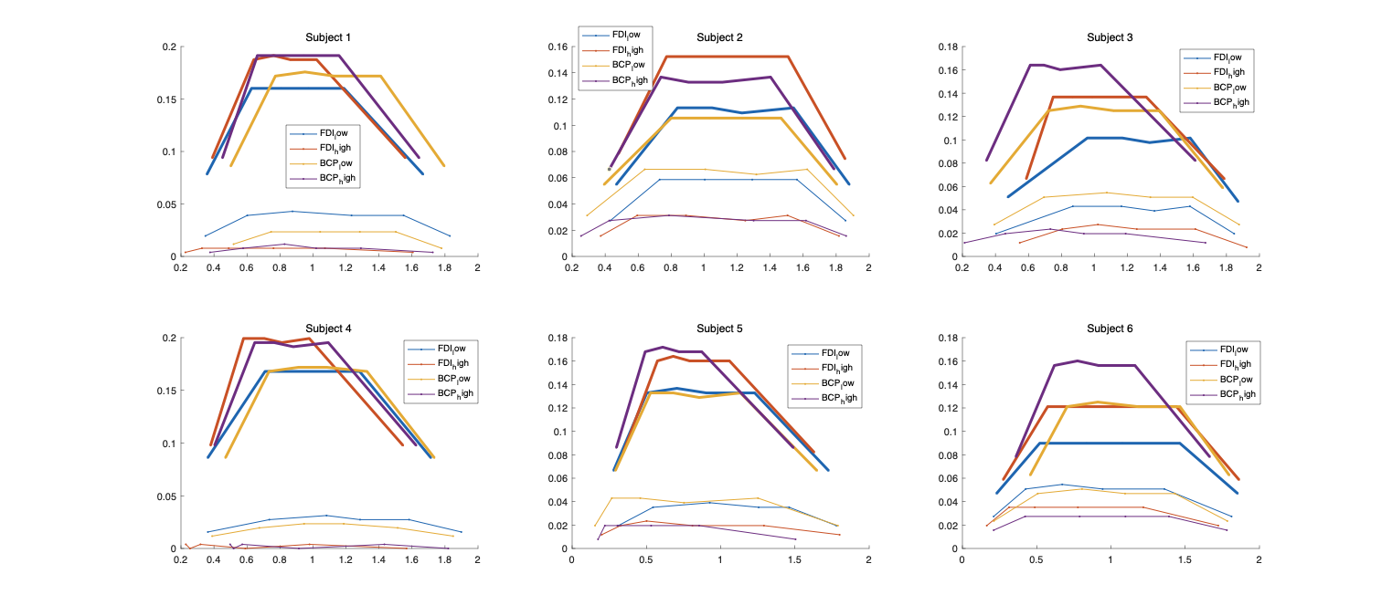
PDF pre subject

Slide 8
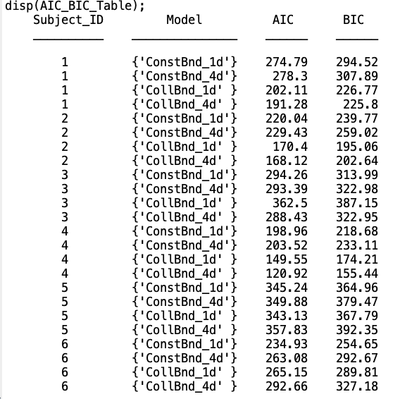
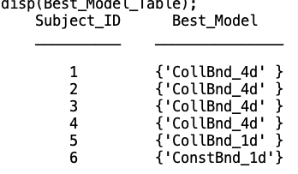
AIC/BIC table

Slide 9
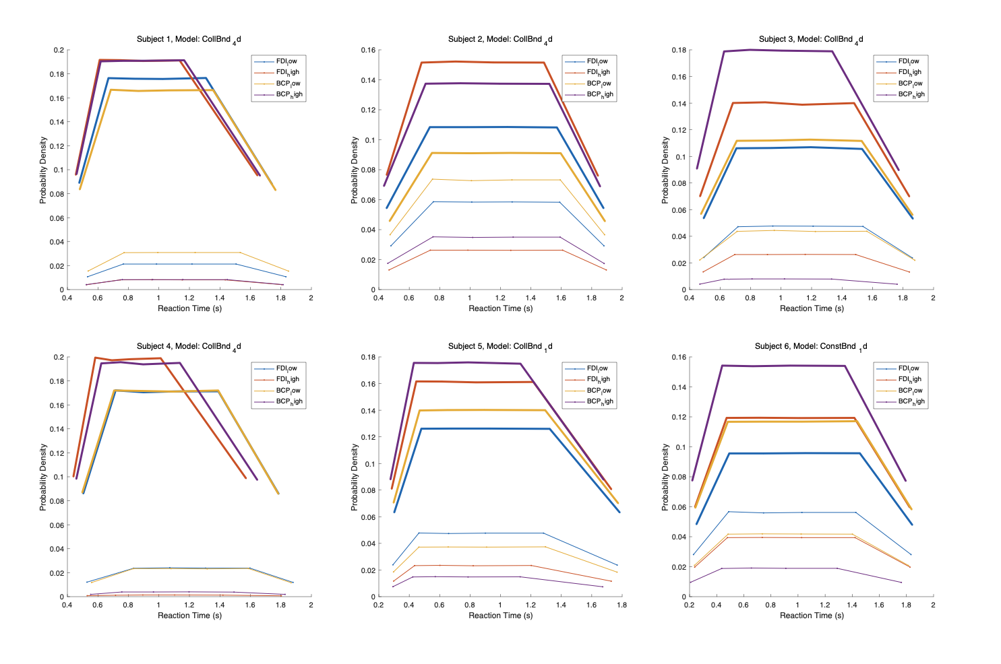
Simulated data

Slide 10
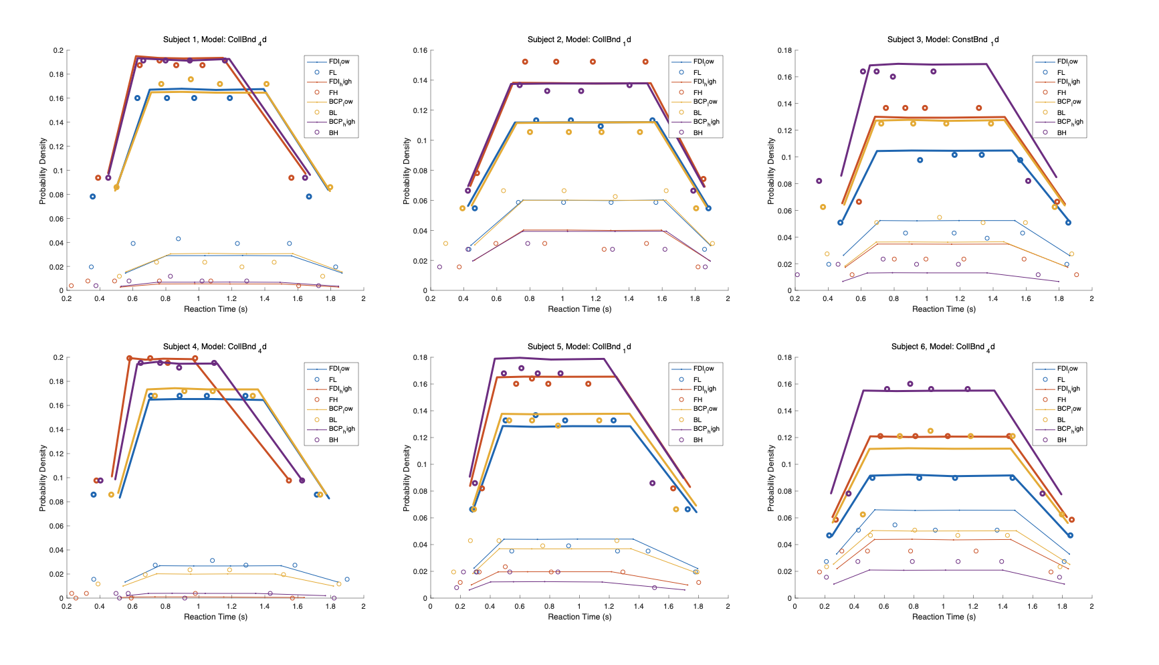
All sub together

Slide 11
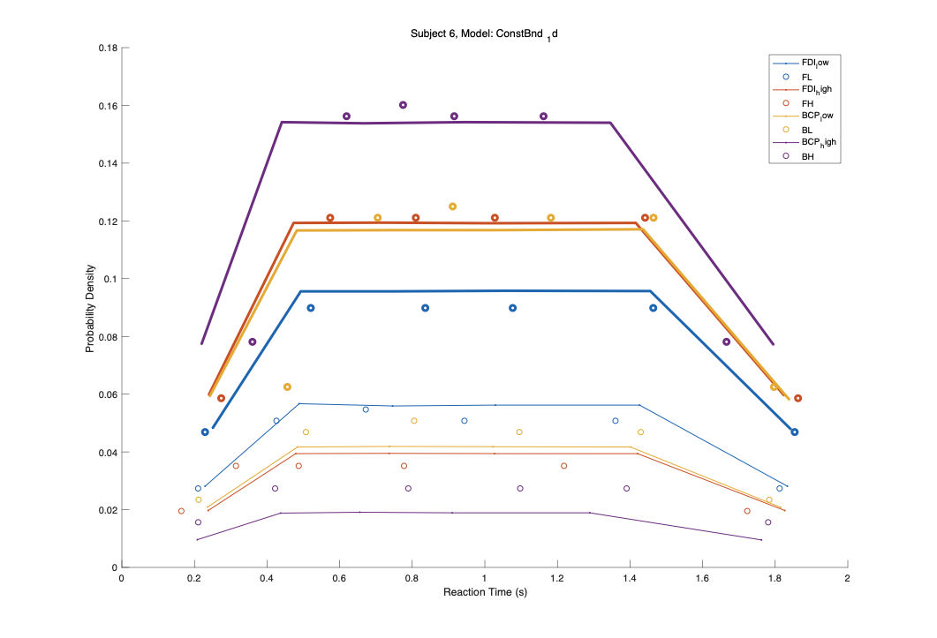
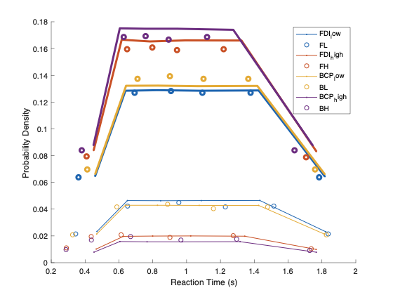
Avg all parameter （left individual avg）（right all avg）

Slide 12
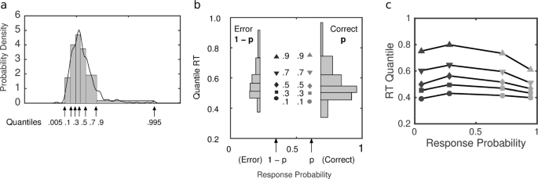
Example (c)

Slide 13
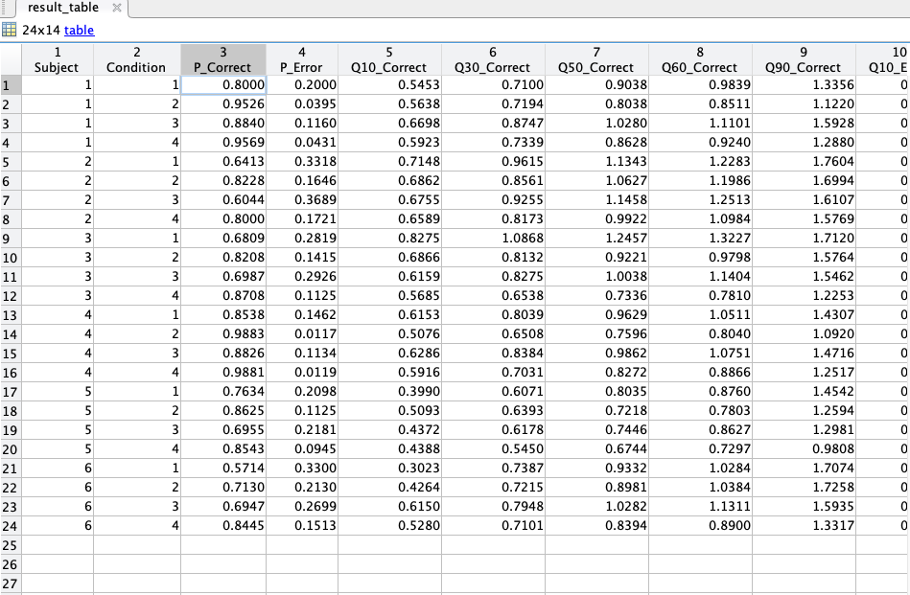

Slide 14
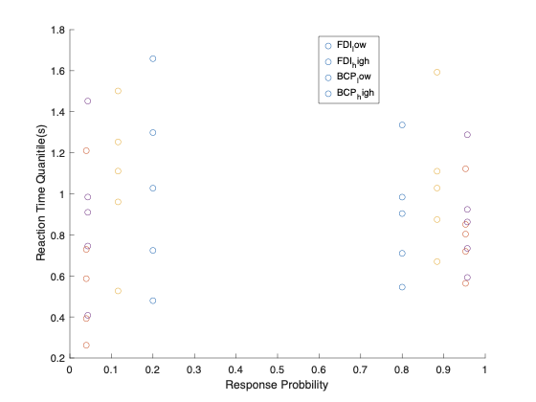

Slide 16
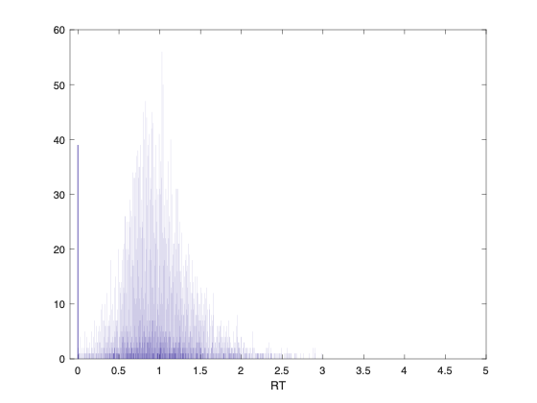
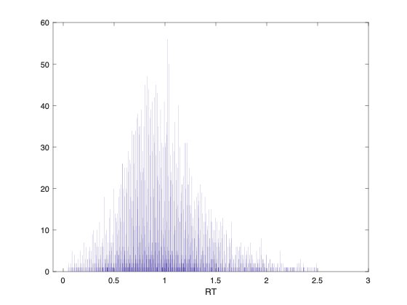
EXP2 (2.5ddl 0.05/0.1 coh)

Slide 17
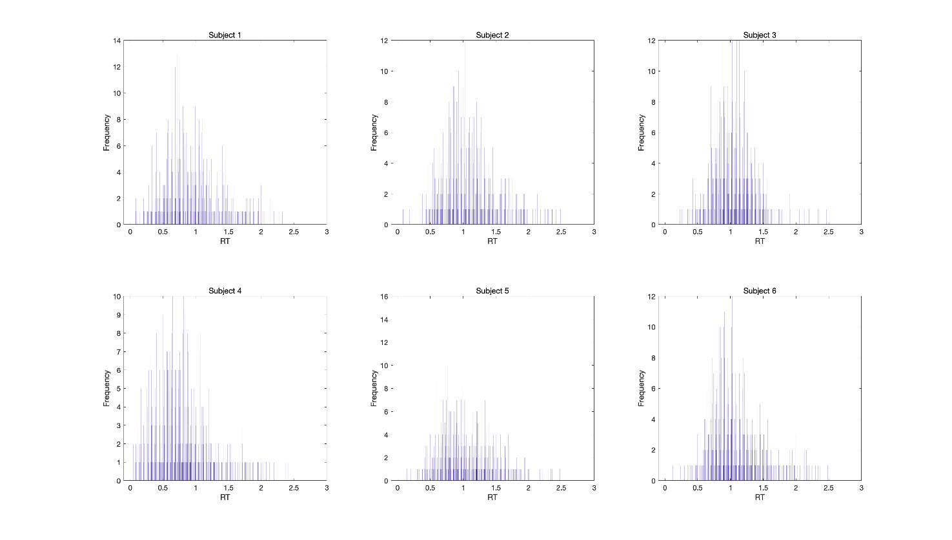

Slide 18
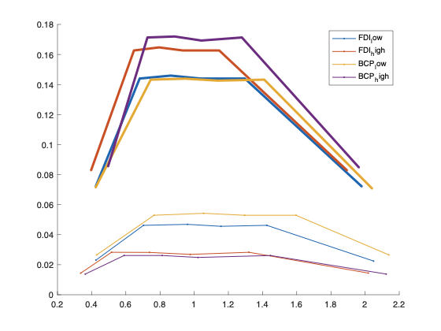

Slide 19
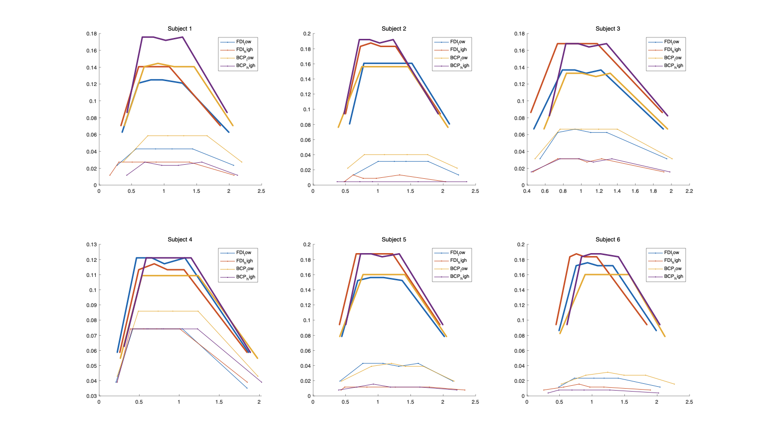

Slide 20
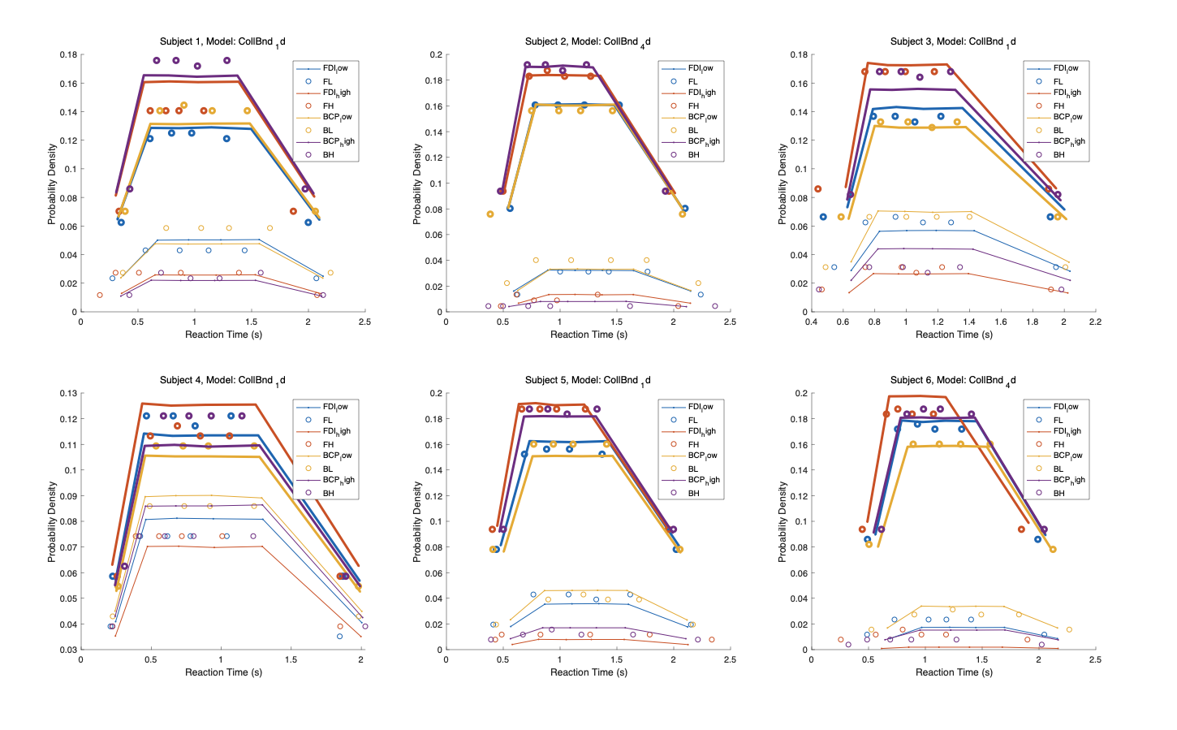

Slide 21
Mar 20 update
EXP 1

Slide 22


For best AIC

Slide 23
For best avg AIC CollBnd_1d

Slide 24
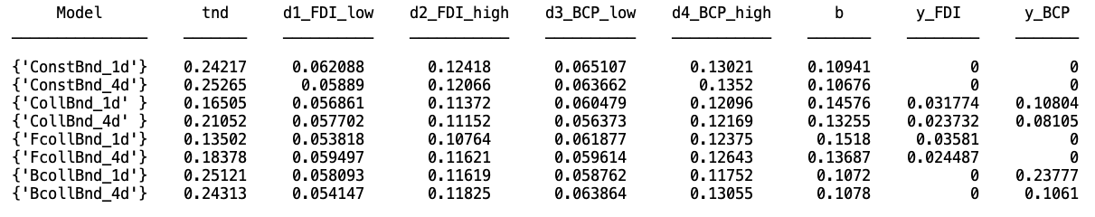
Avg parameters

Slide 25
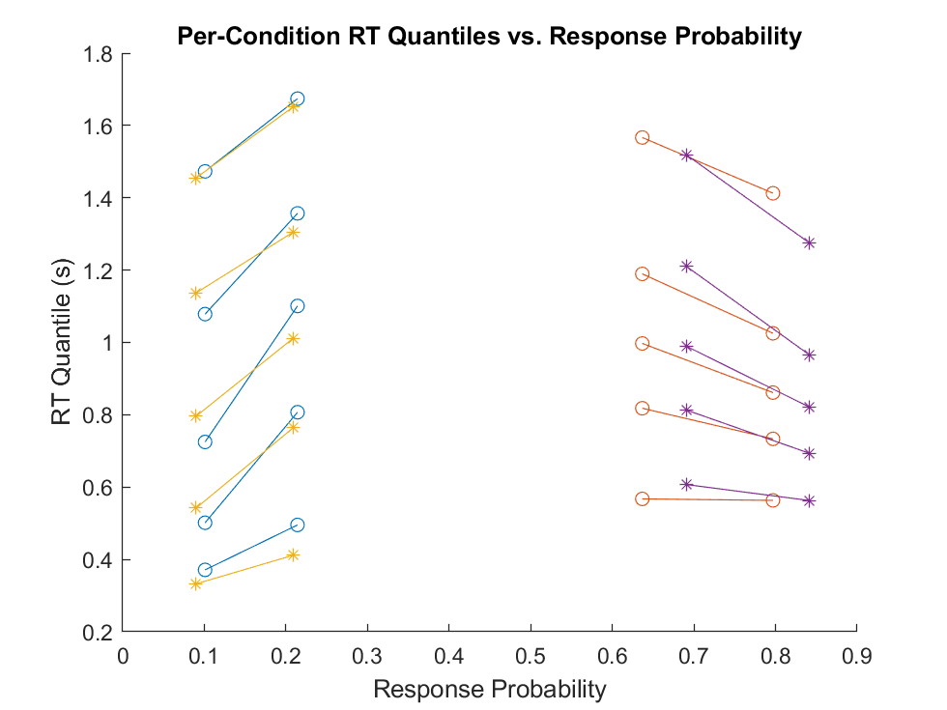
Avg plot FDI：o; BCP: *

Slide 26
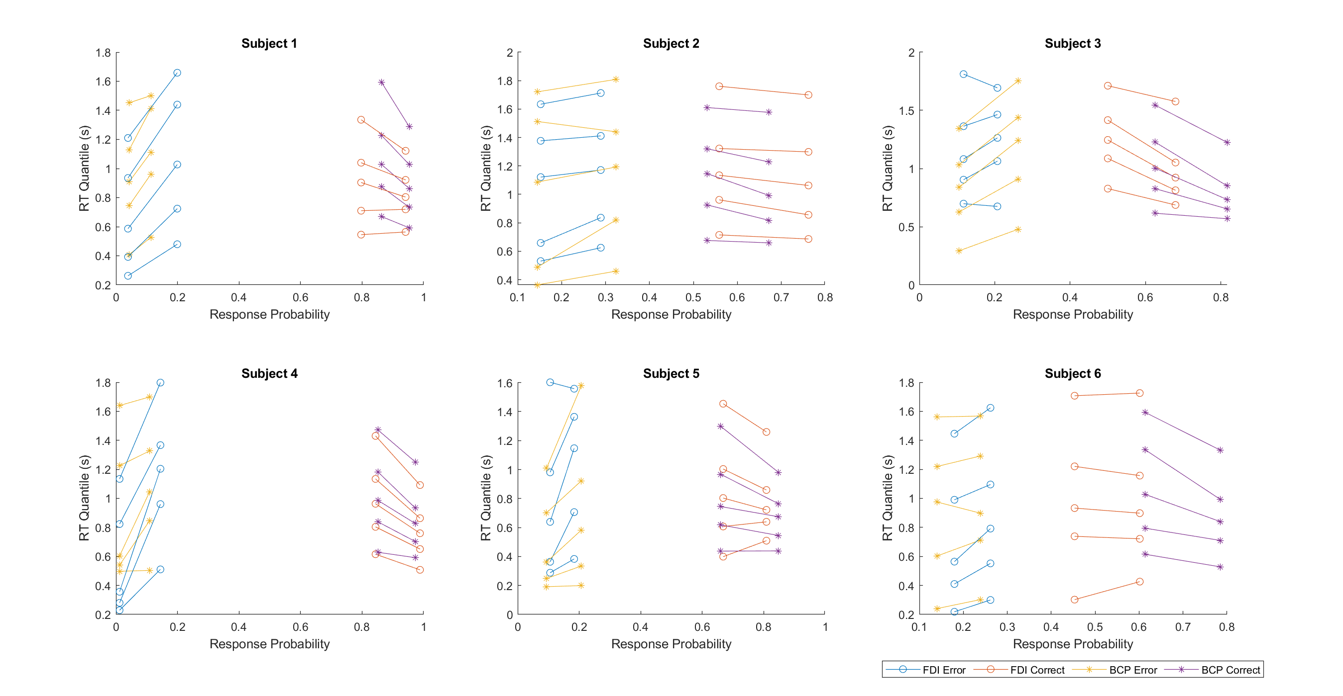

Slide 27
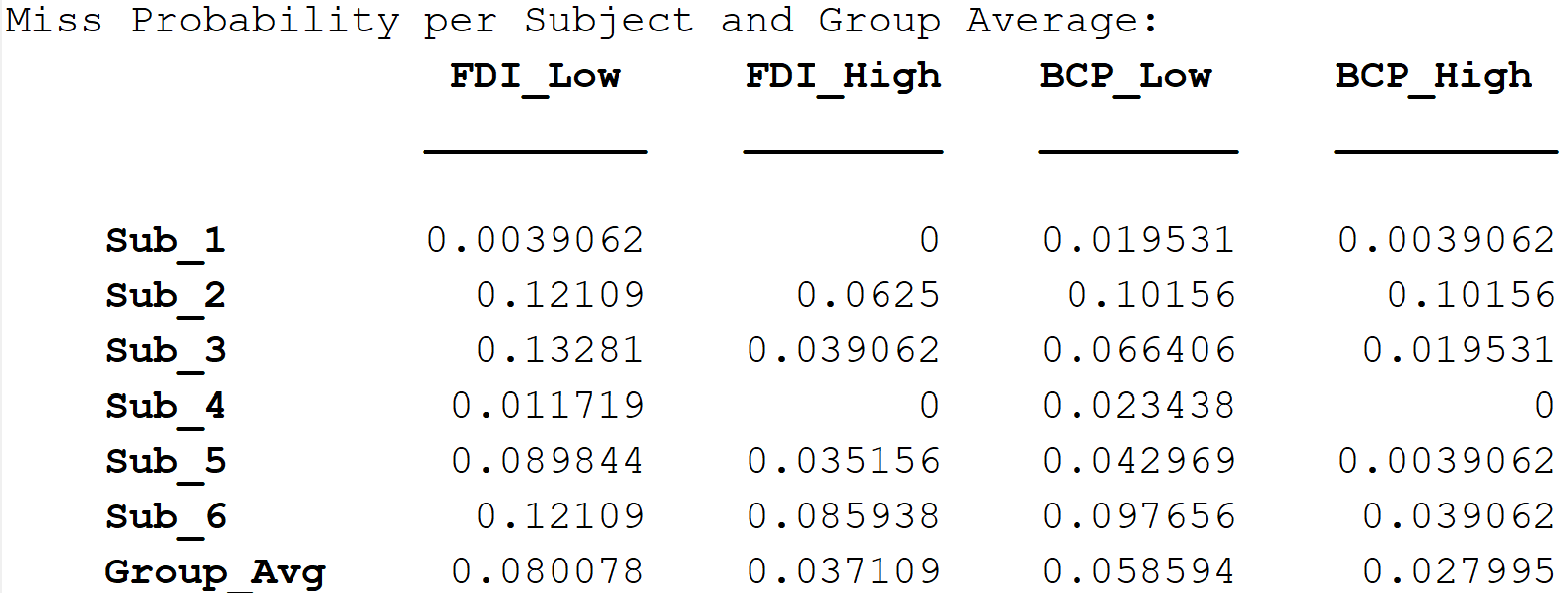

Slide 28
EXP 2 update （plot change after re-define miss）

Slide 31
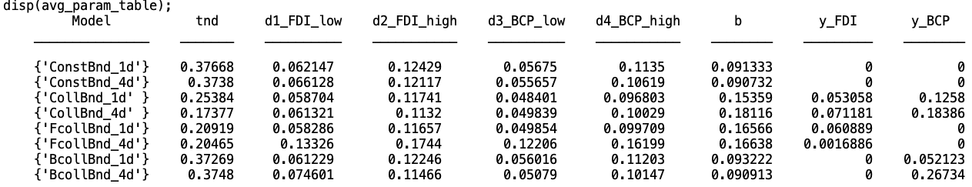
Avg parameters

Slide 32
FcollBnd_1d (Lowest average AIC)

Slide 33
FcollBnd_1d (Lowest average AIC)

Slide 34
Avg plot FDI：o; BCP: *

Slide 36
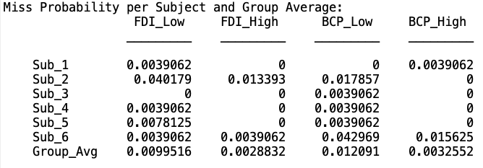

Slide 38
EXP 2 EMG update （plot change after re-define miss）

Slide 41
FcollBnd_1d (Lowest average AIC)

Slide 42
FcollBnd_1d (Lowest average AIC)

Slide 43
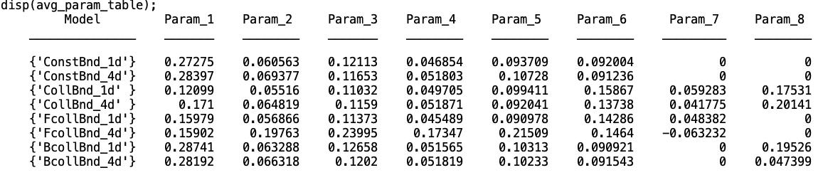

Slide 44
Avg plot FDI：o; BCP: *

Slide 46
